Slide 2
Add style + good looks
to your SASSIE system

Slide 3
Match the branding, look & feel
of clients’ companies

Slide 4
Deliver professional looking
SASSIE websites

Slide 5
Fast

Slide 6
Without the aid of a design team

Slide 7
Let’s make some themes

Slide 8
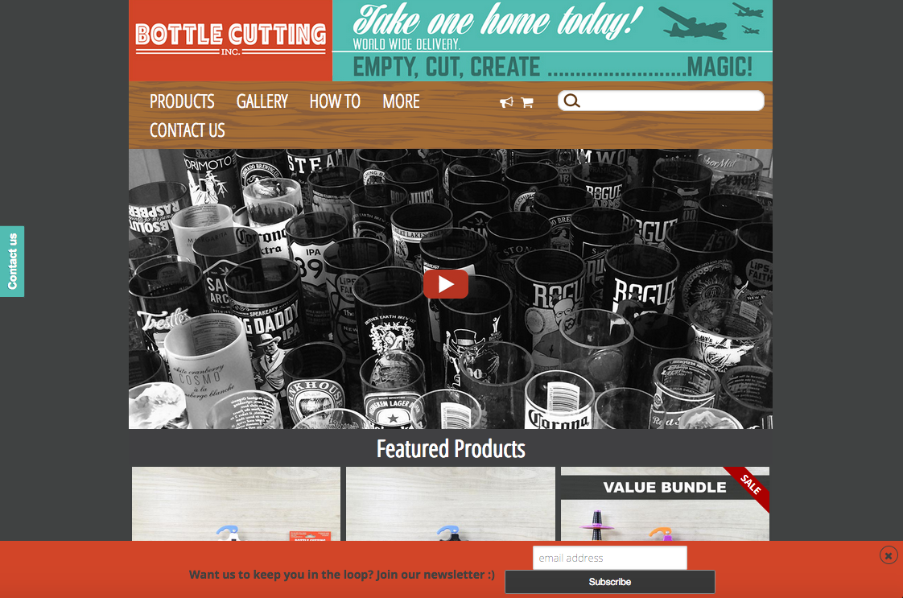
Let’s make some themes:
REAL WEBSITE: www.bottlecutting.com

Slide 9
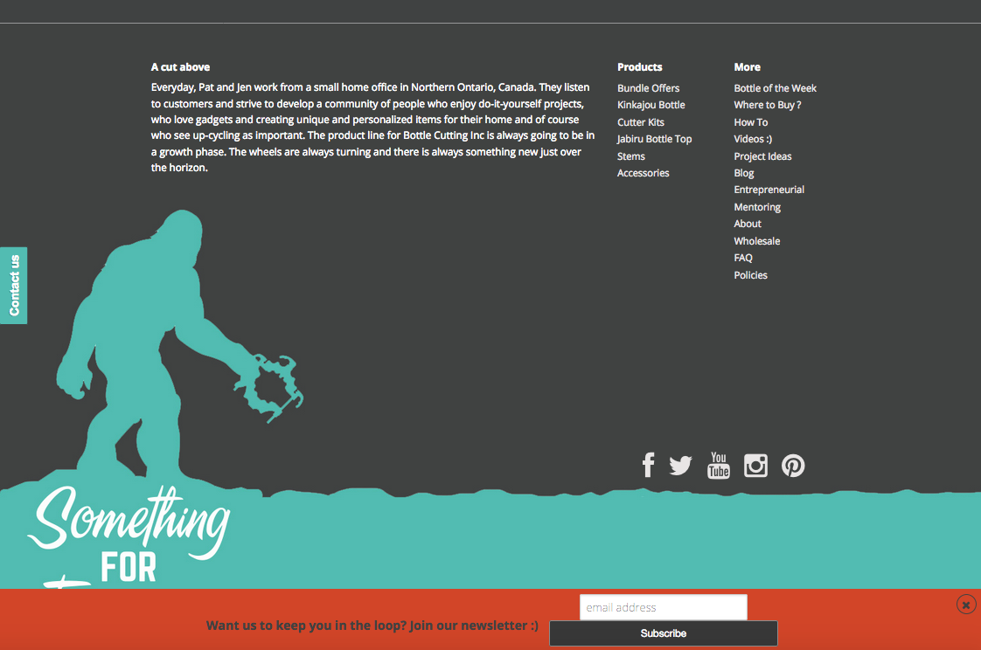
Let’s make some themes:
REAL WEBSITE

Slide 10
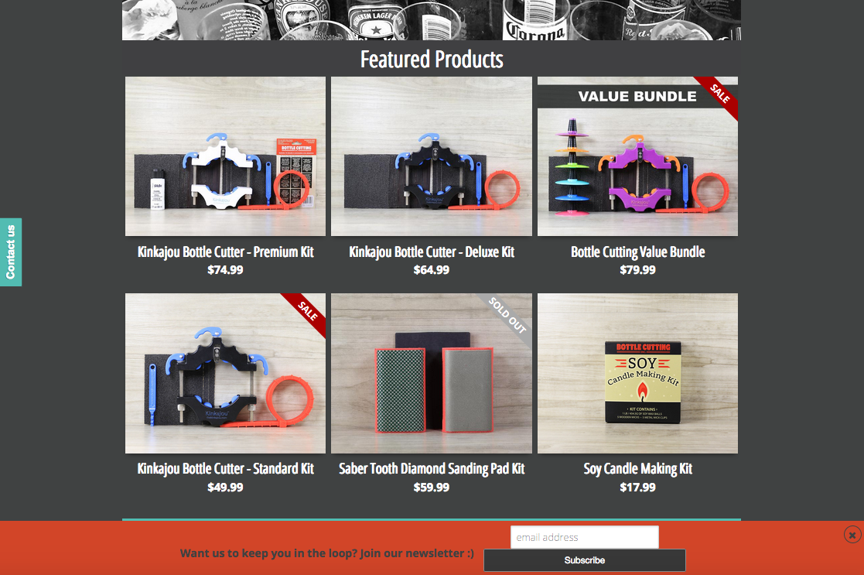
Let’s make some themes:
REAL WEBSITE

Slide 11
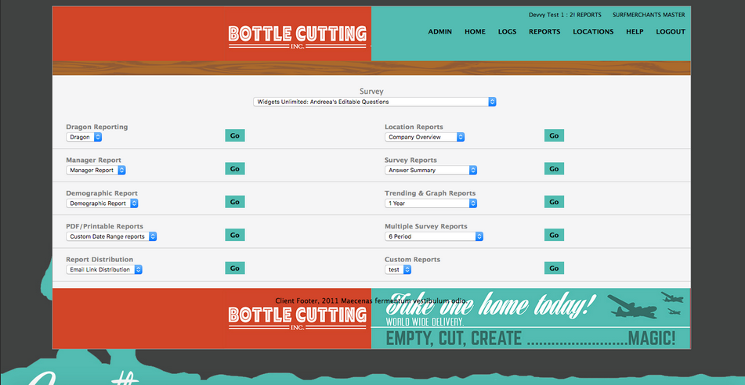
Let’s make some themes
SASSIE TC3 THEME

Slide 12
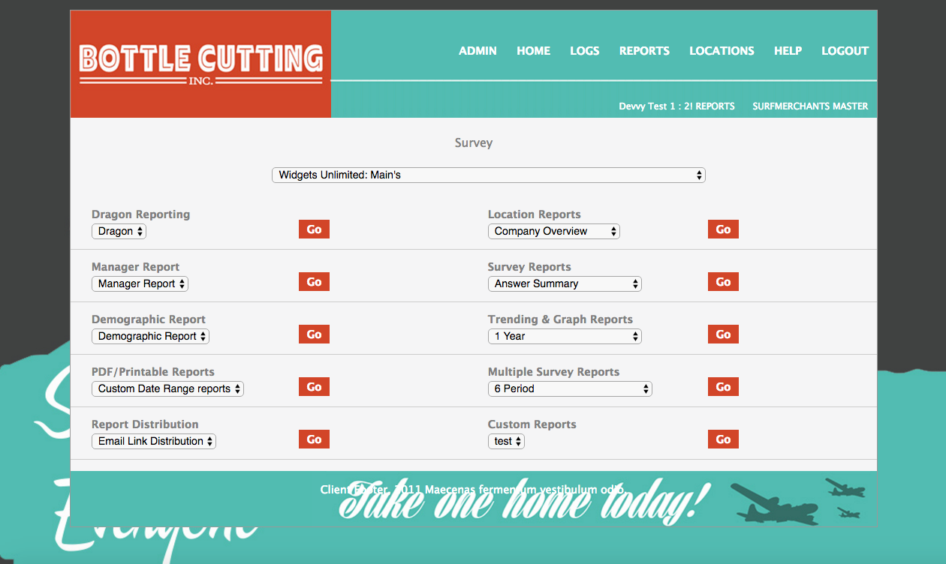
Let’s make some themes
SASSIE TC3 THEME

Slide 13
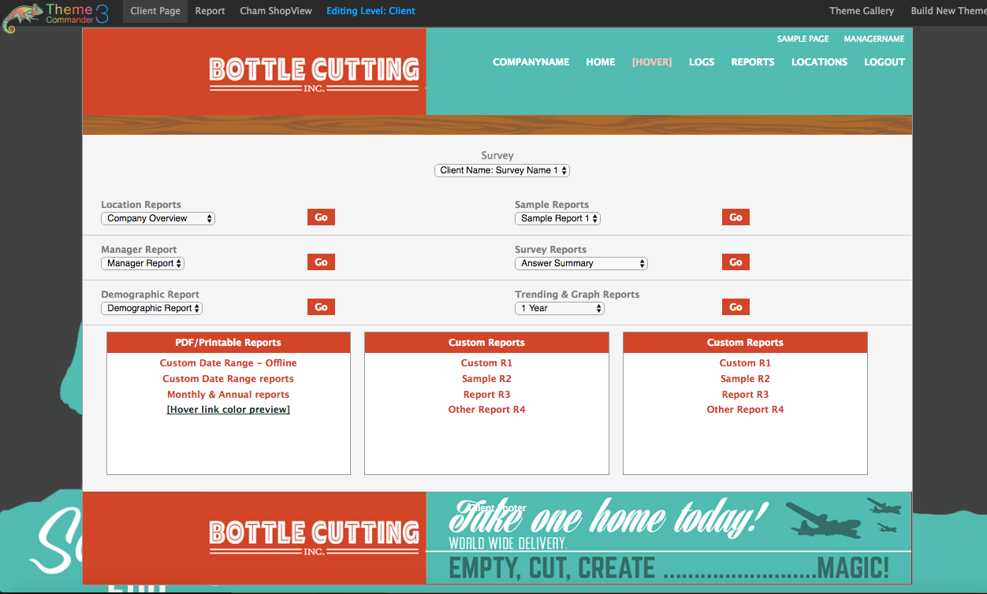
Let’s make some themes
SASSIE TC3 THEME

Slide 14
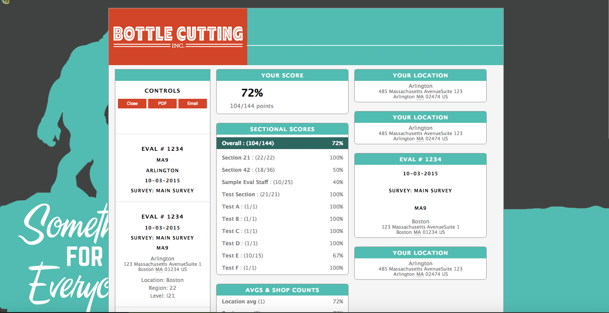
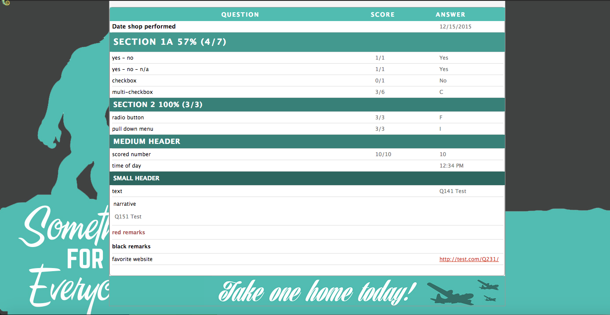
Let’s make some themes
SASSIE TC3 THEME

Slide 15
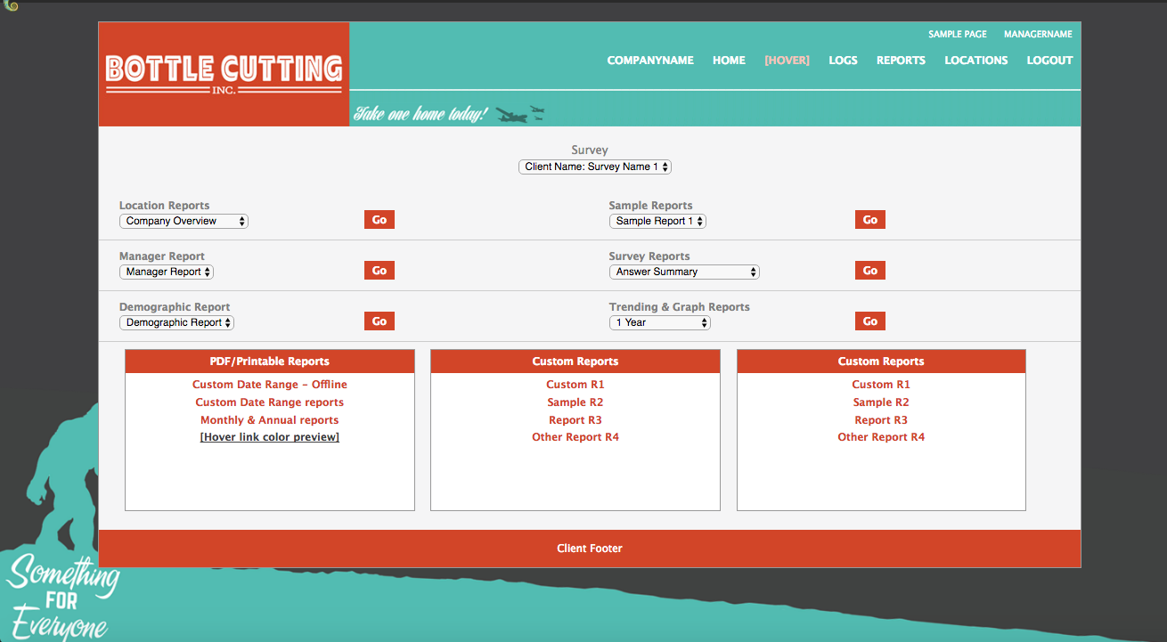
Let’s make some themes
SASSIE TC3 THEME

Slide 16
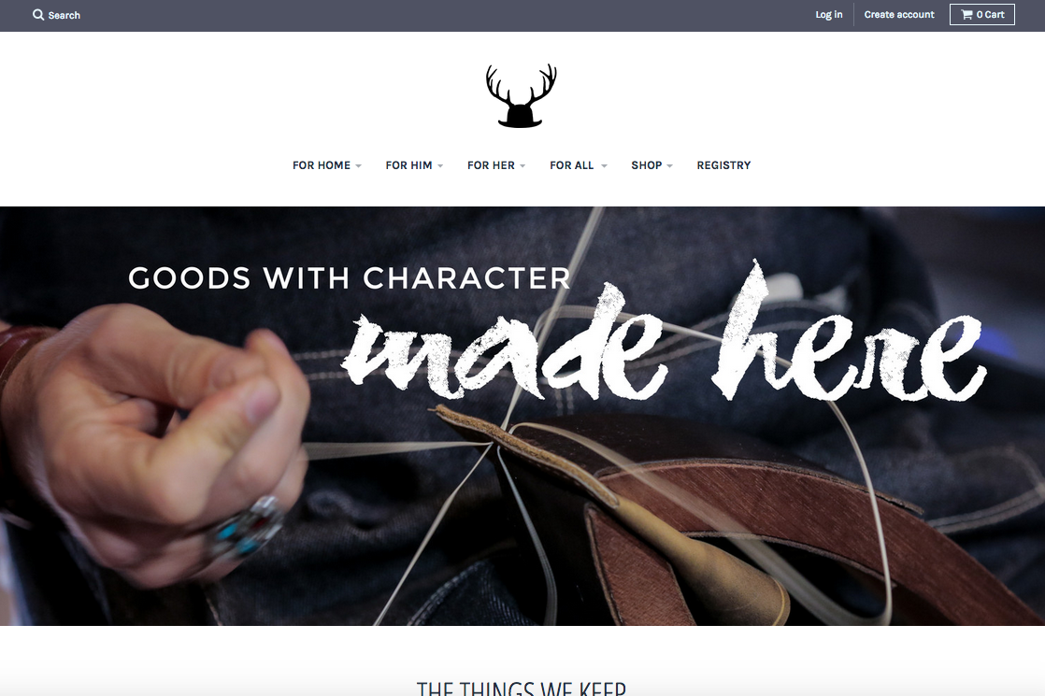
Let’s make some themes
ANOTHER REAL WEBSITE: www.commondeervt.com

Slide 17
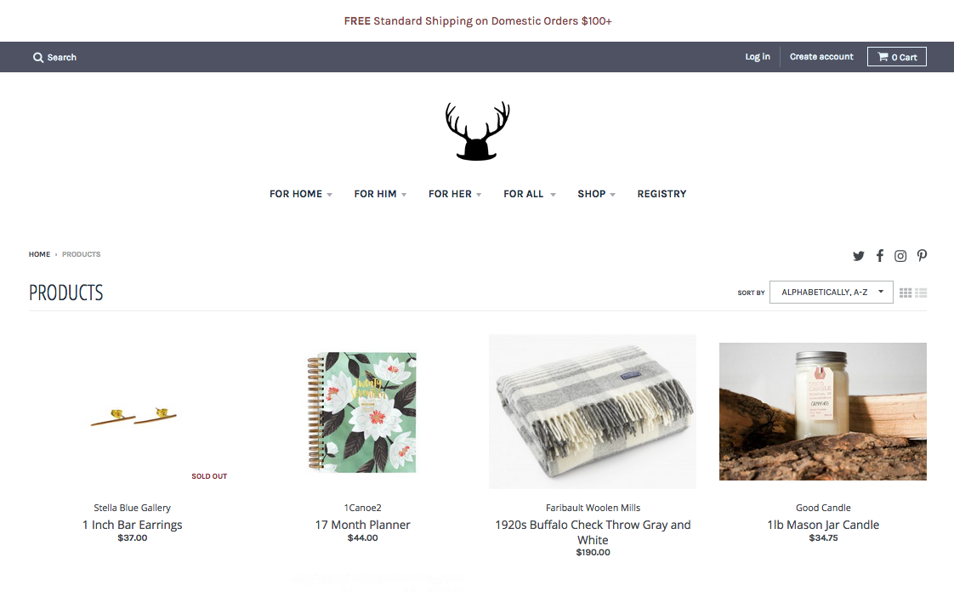
Let’s make some themes
ANOTHER REAL WEBSITE

Slide 18
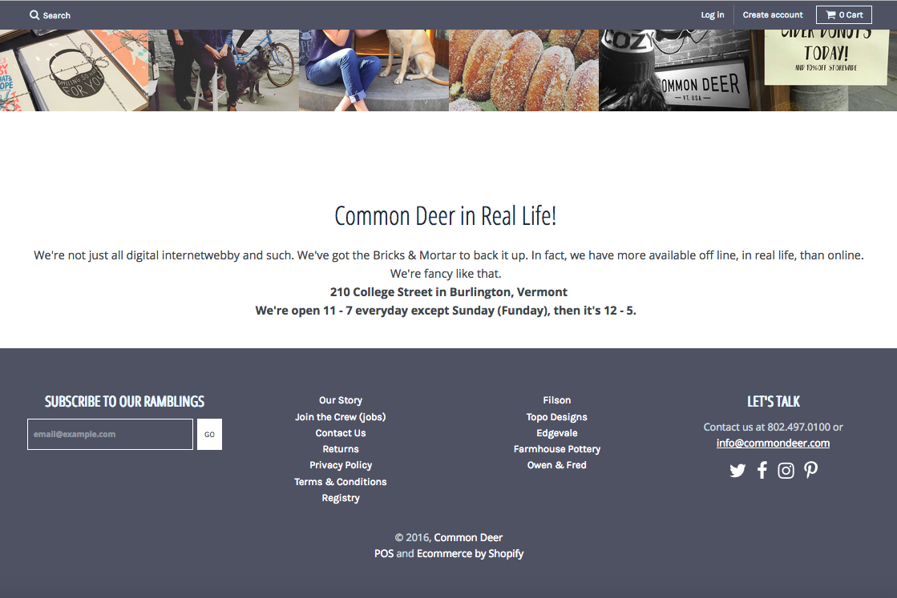
Let’s make some themes
ANOTHER REAL WEBSITE

Slide 19
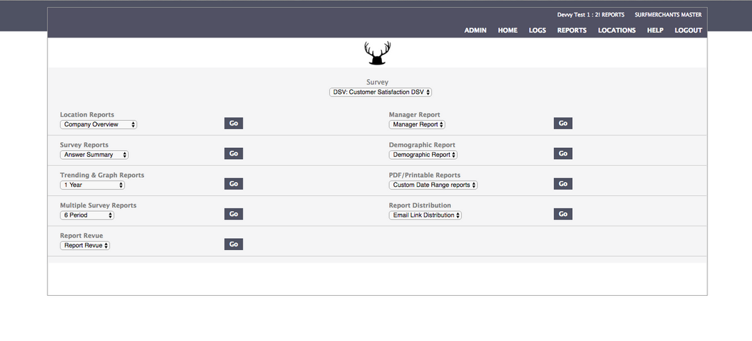
Let’s make some themes
SASSIE TC3 THEME

Slide 20
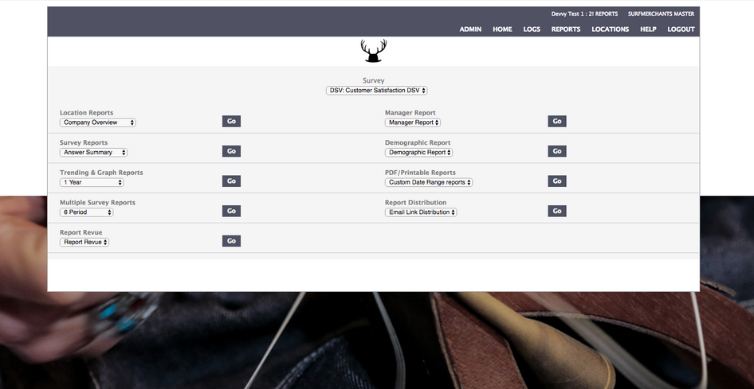
Let’s make some themes
SASSIE TC3 THEME

Slide 21
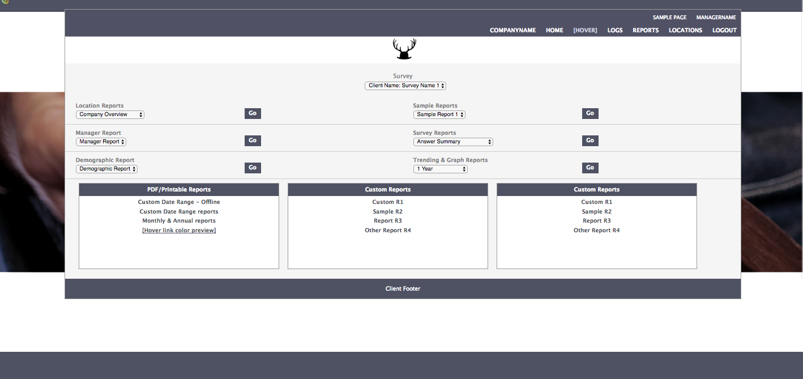
Let’s make some themes
SASSIE TC3 THEME

Slide 22
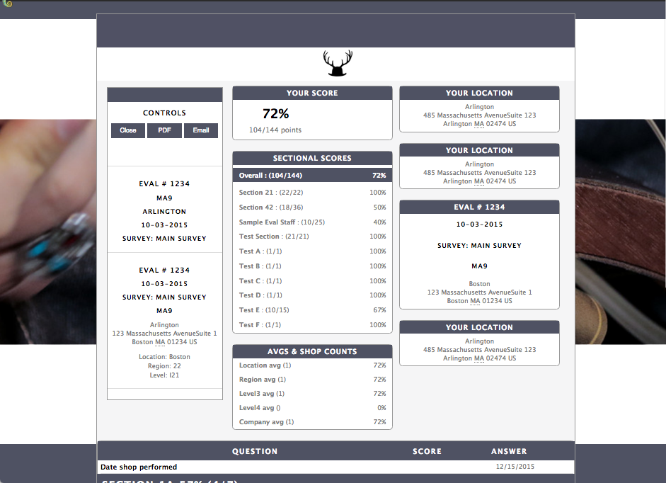
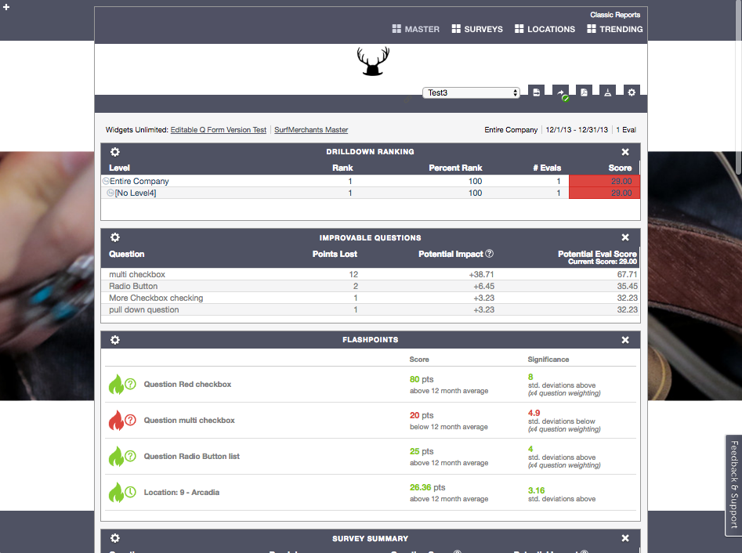
Let’s make some themes
SASSIE TC3 THEME

Slide 23
Let’s make some themes

Slide 24
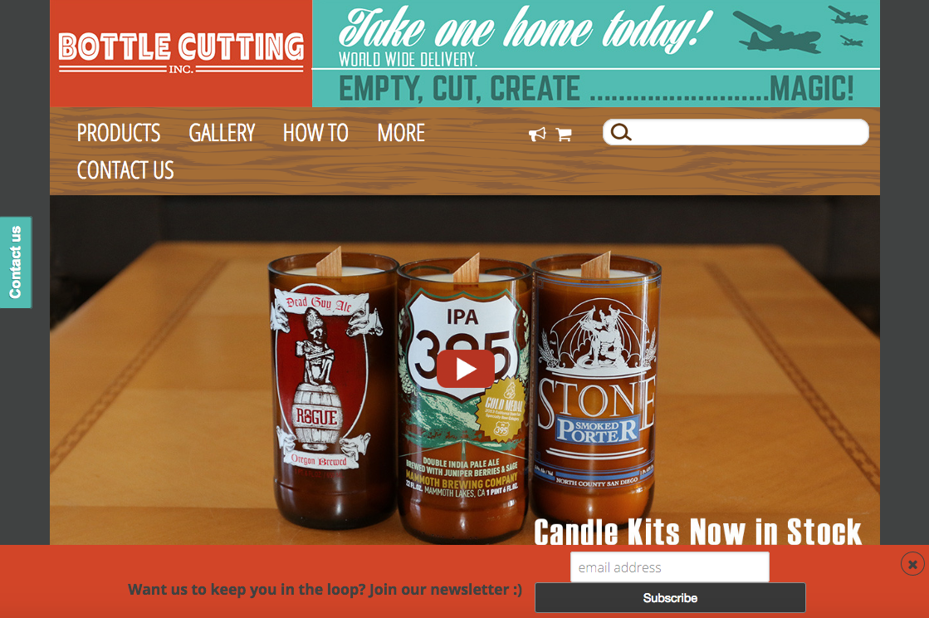
Let’s make some themes

Slide 25
Theme-making steps
Do your research:
Identify Colors
Select Images
Plan your layout:
Compare your client’s website to a regular SASSIE look
Colors: How many? Where?
Images: Crop? Combine?
Execute the plan:
Work with your colors
Work with your images
Put it all together

Slide 26
Working with Colors

Slide 27
Some Helpful Tools
Color Picker - Lets you match colors on websites
Plenty of free extensions for both Chrome (Eye Dropper) and Firefox (colorPicker)

Slide 28
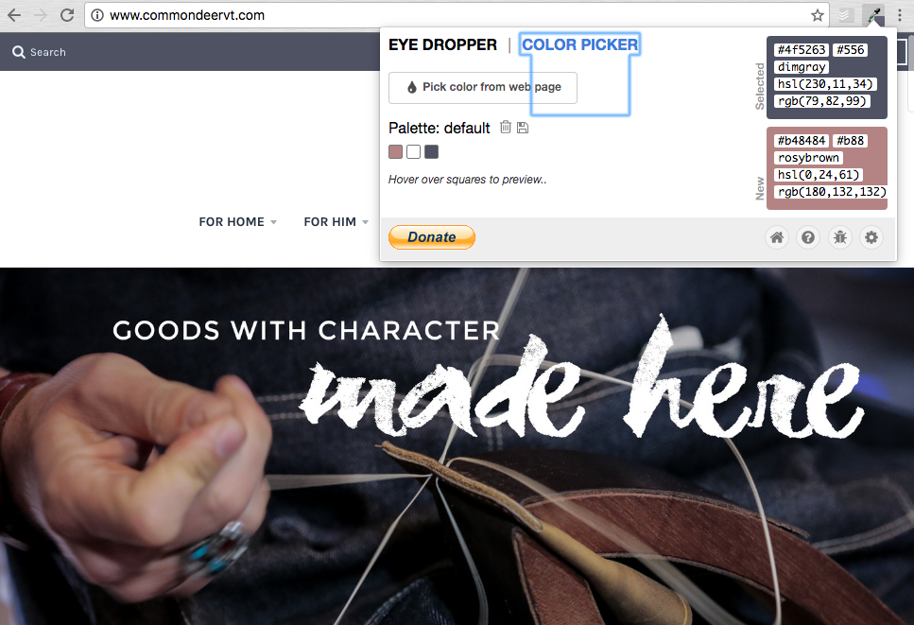
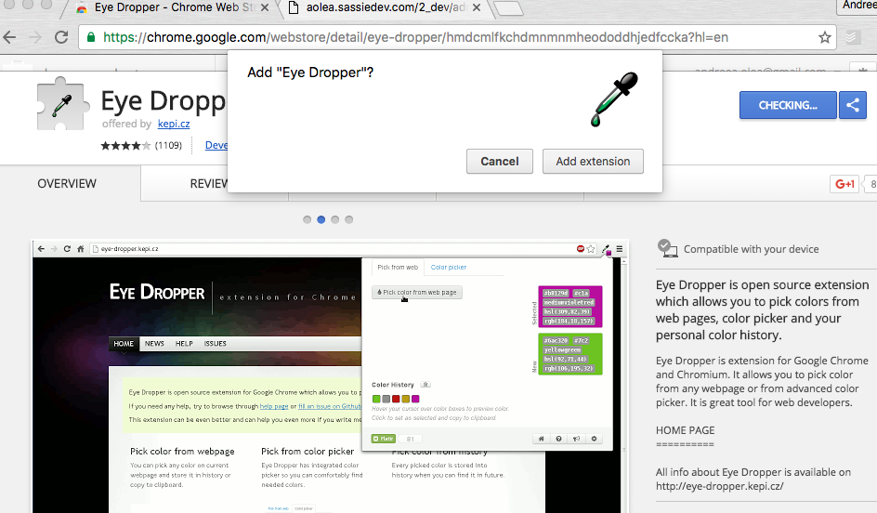
Some Helpful Tools: Color Pickers

Slide 29
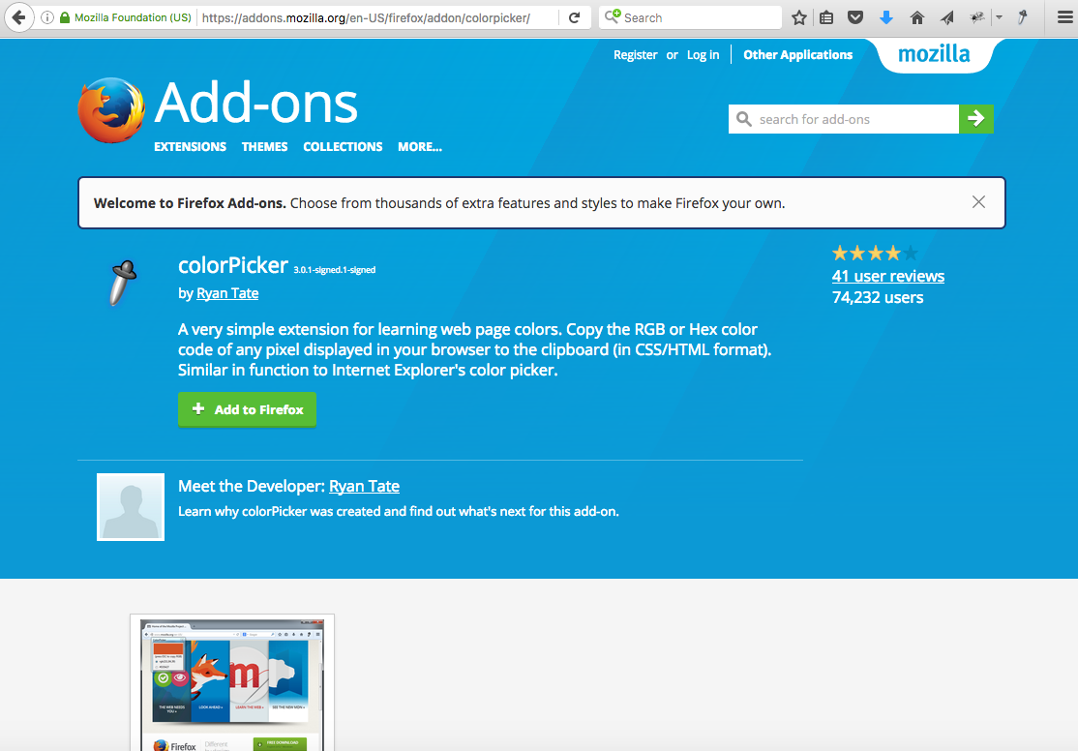
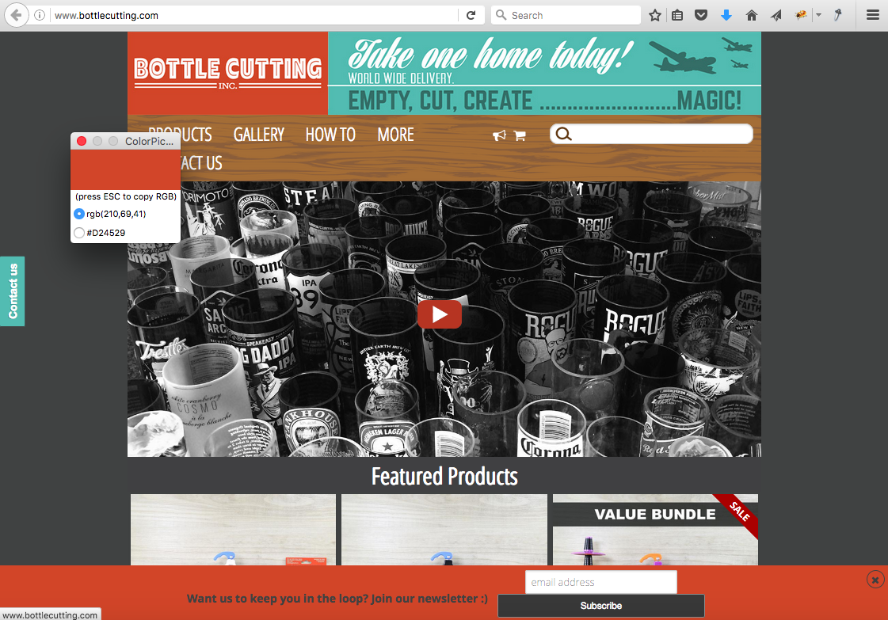
Some Helpful Tools: Color Pickers

Slide 30
Some Helpful Tools
Color Picker - Lets you match colors on websites
Plenty of free extensions for both Chrome (Eye Dropper) and Firefox (colorPicker)
Alternative:
Ask your client
Advanced users:
Inspect webpage elements/CSS to find Hex color

Slide 31
Some Helpful Tools
Palette tools - Let you find Analogous, Shades or Complementary Colors.
Lots of Online Resources like
https://color.adobe.com/
http://www.color-hex.com/
http://www.colorhexa.com/
91766F

Slide 32
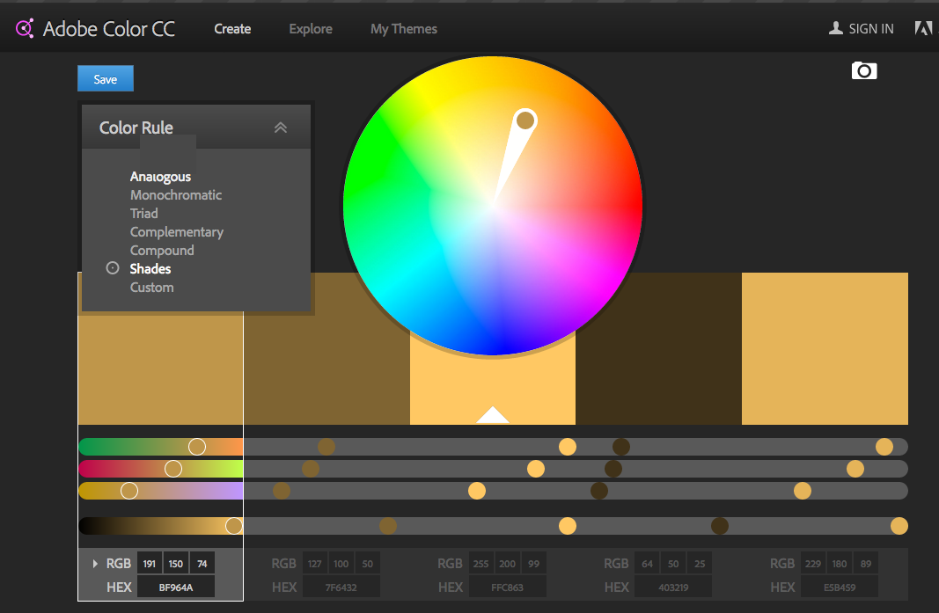
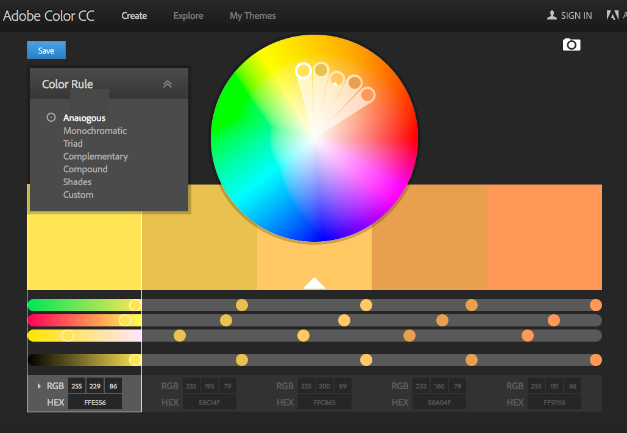
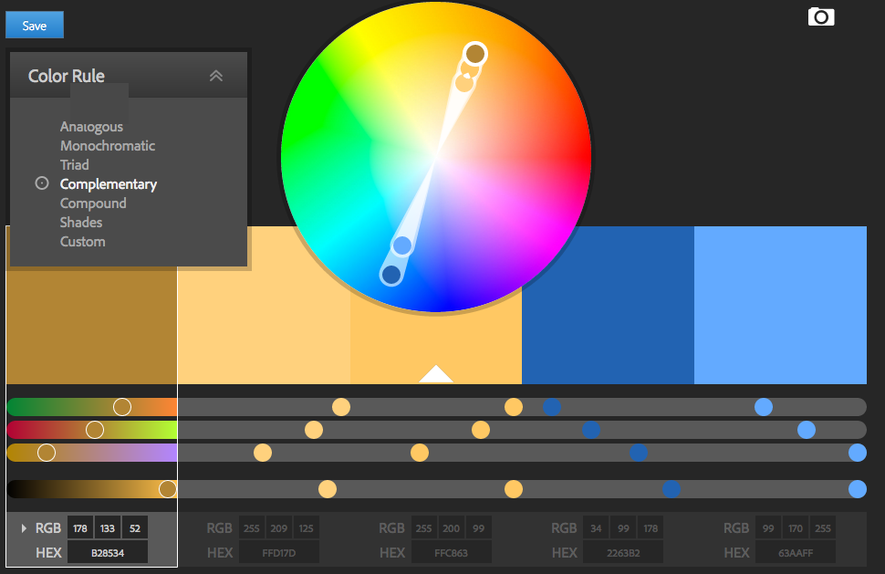
Some Helpful Tools: Pallete Tools
91766F

Slide 33
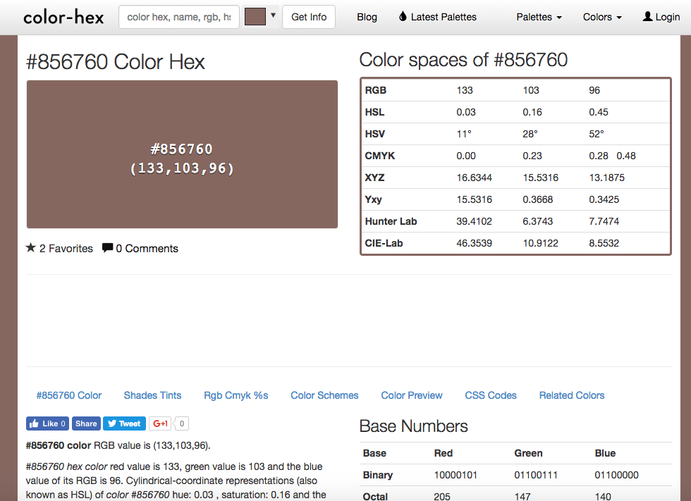
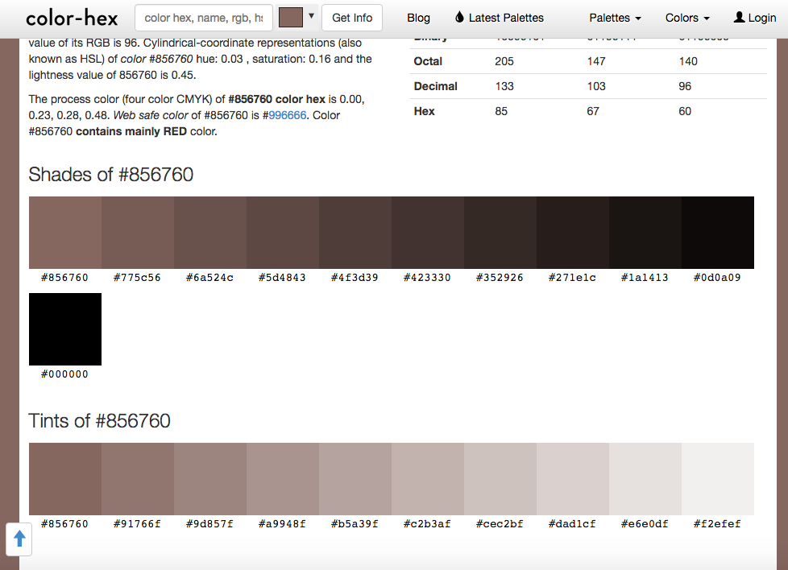
Some Helpful Tools: Pallete Tools
91766F

Slide 34
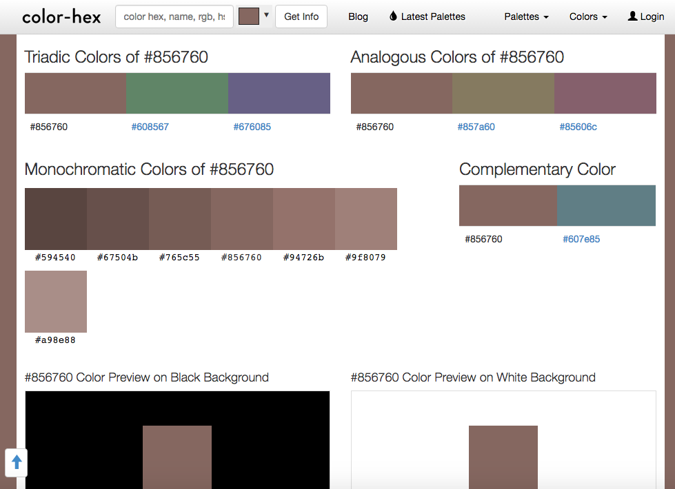
Some Helpful Tools: Pallete Tools
91766F

Slide 35
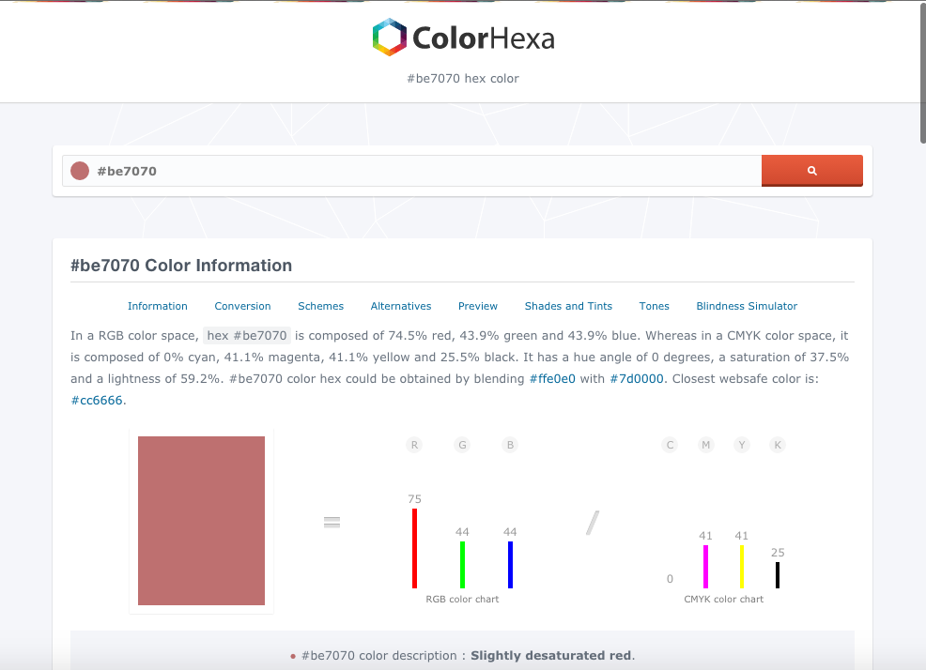
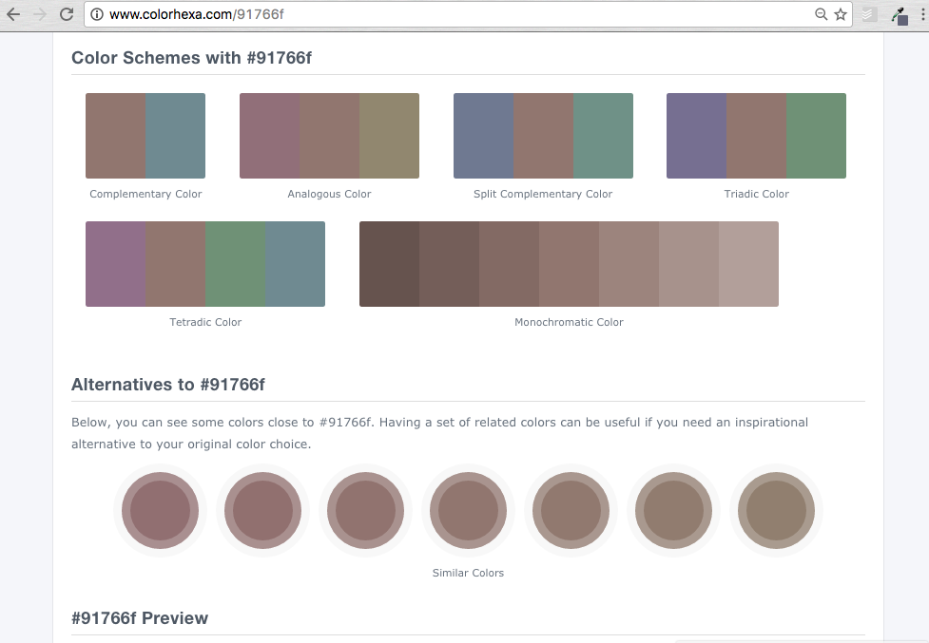
Some Helpful Tools: Pallete Tools
91766F

Slide 36
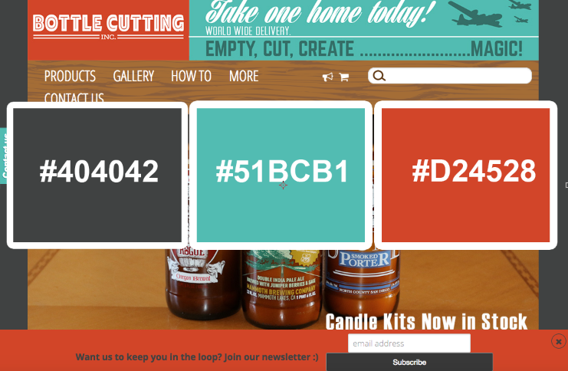
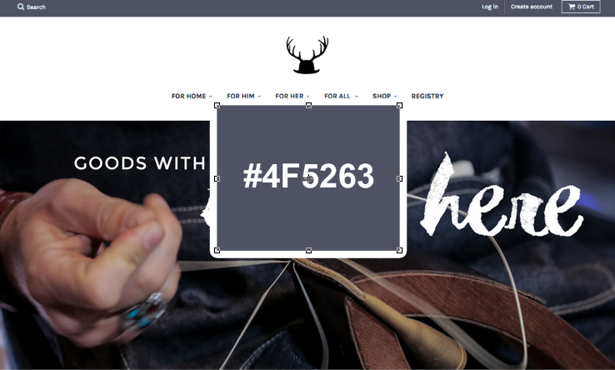
Finding your colors
Identify Primary or Signature Colors
Identify Analogous and Complementary Colors that work together

Slide 37
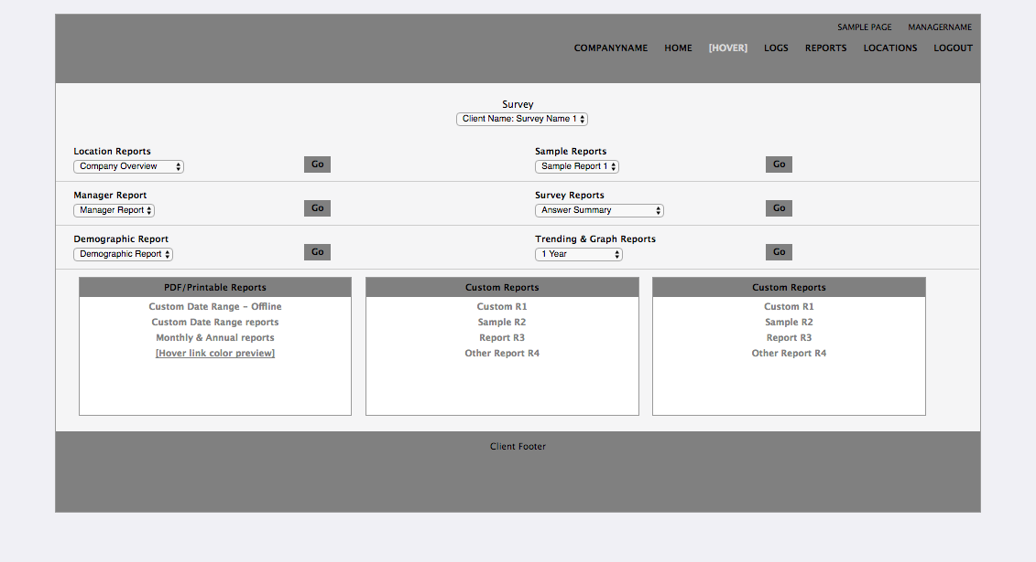
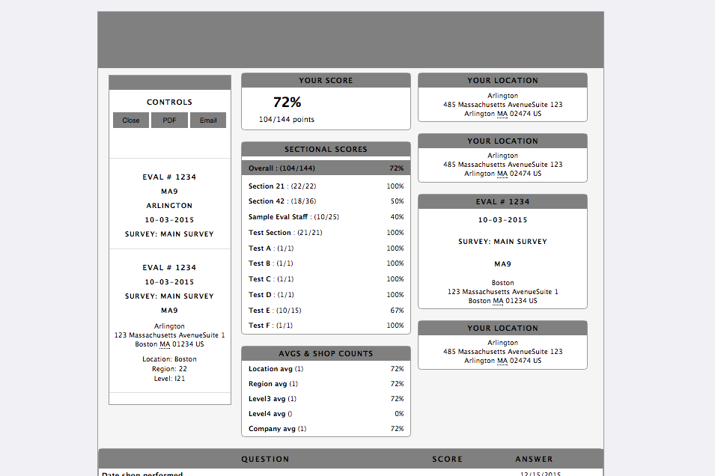
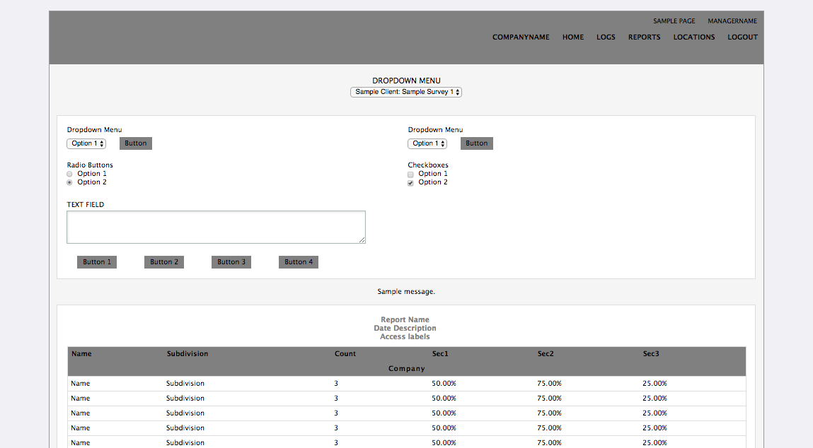
Planning your layout

Slide 38
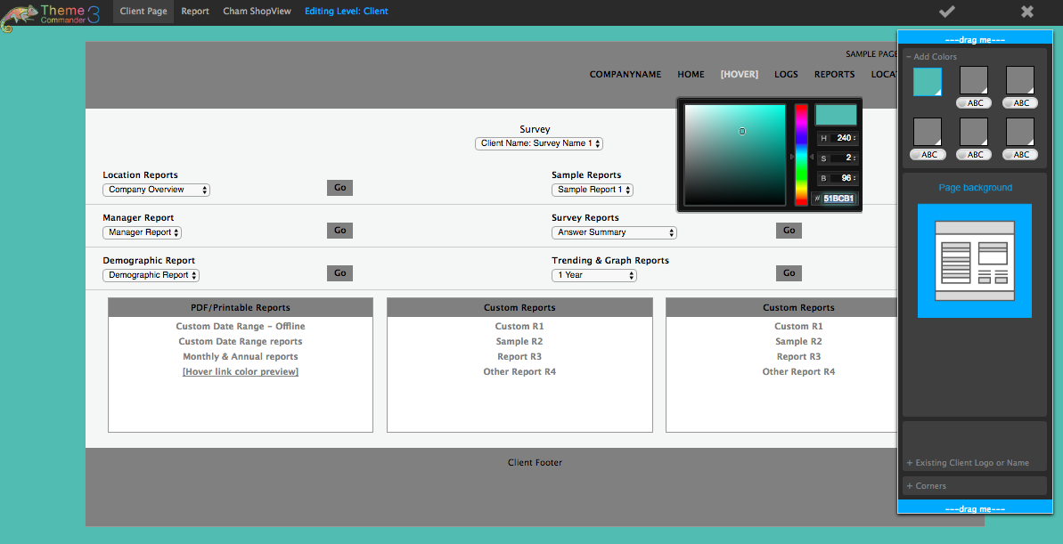
Tips for picking colors:
Background

Slide 39
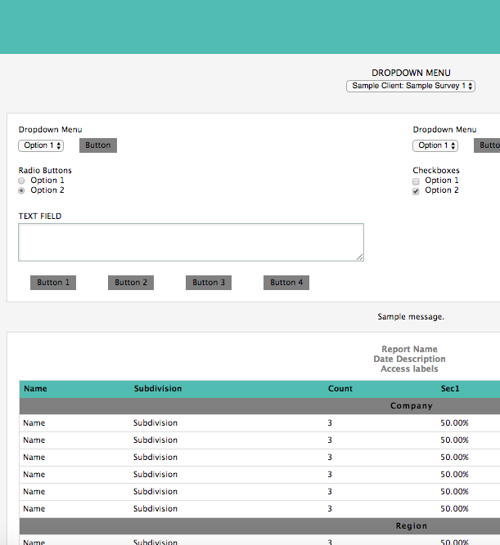
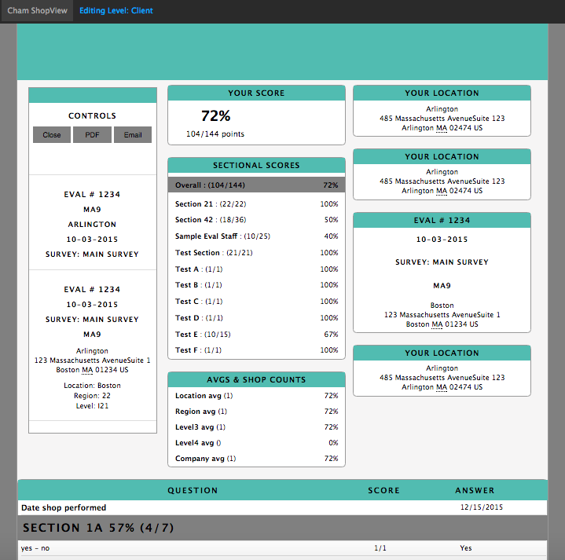
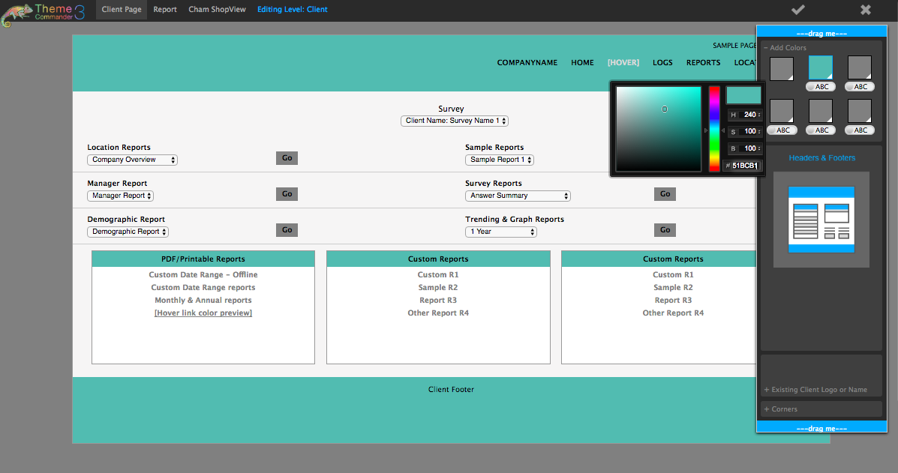
Tips for picking colors:
Headers and Footers

Slide 40
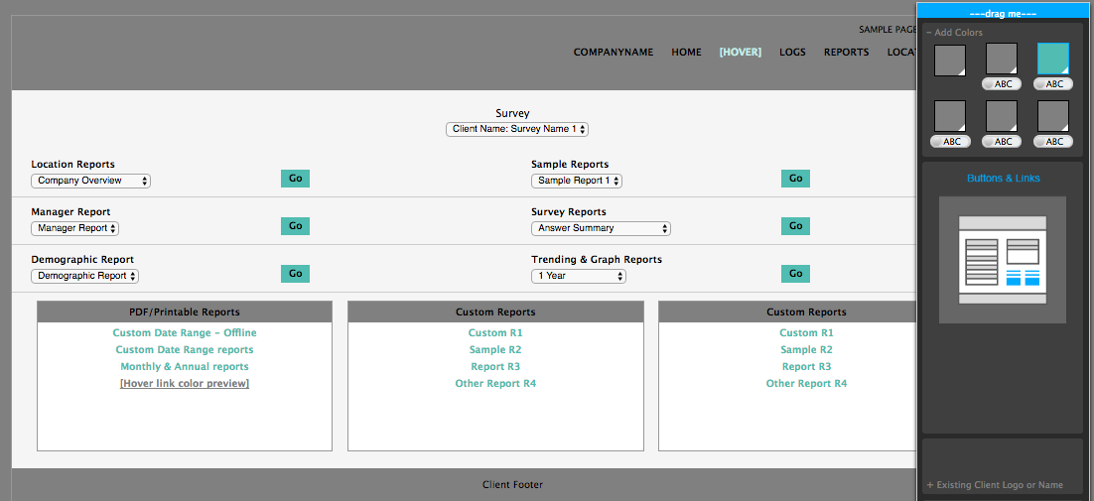
Tips for picking colors:
Buttons and links

Slide 41
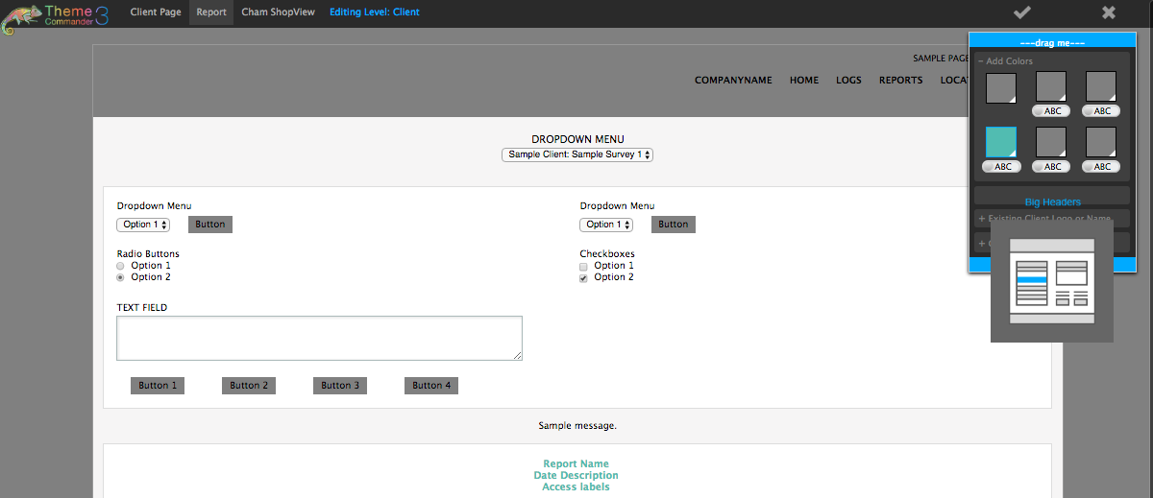
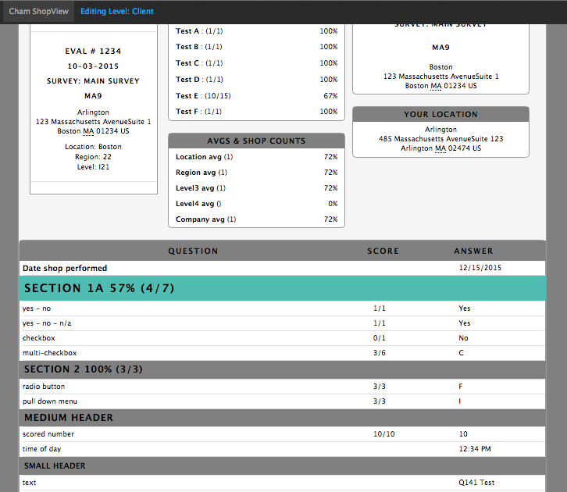
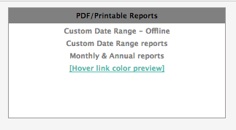
Tips for picking colors:
Big headers and link hover

Slide 42
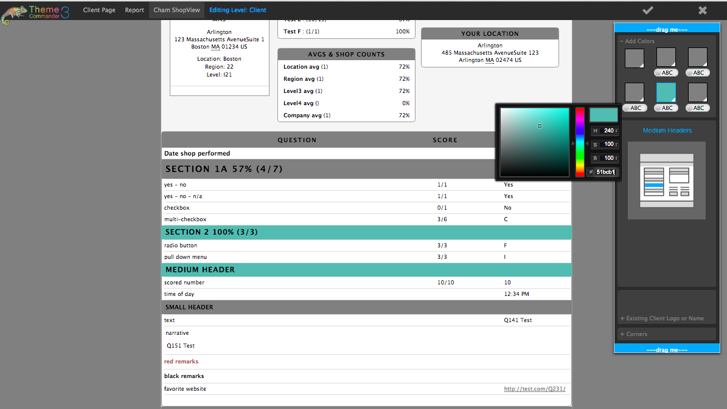
Tips for picking colors:
Medium headers

Slide 43
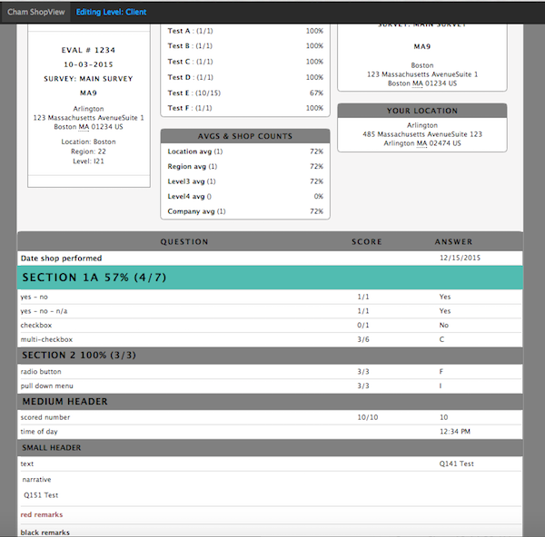
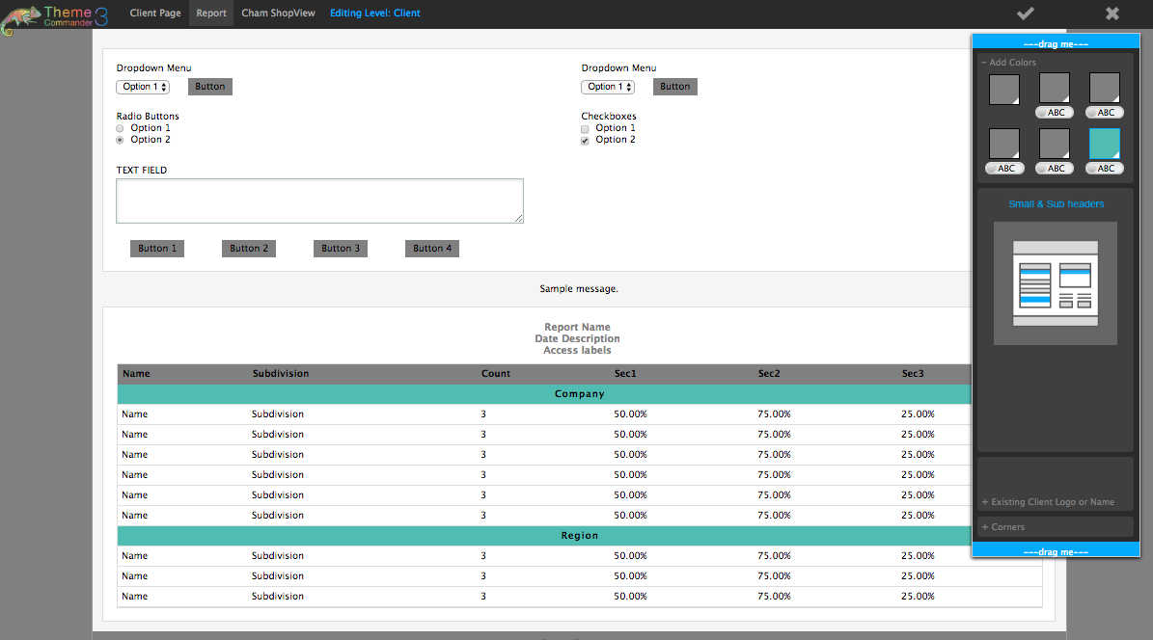
Tips for picking colors:
Small headers

Slide 44
Working with Images

Slide 45
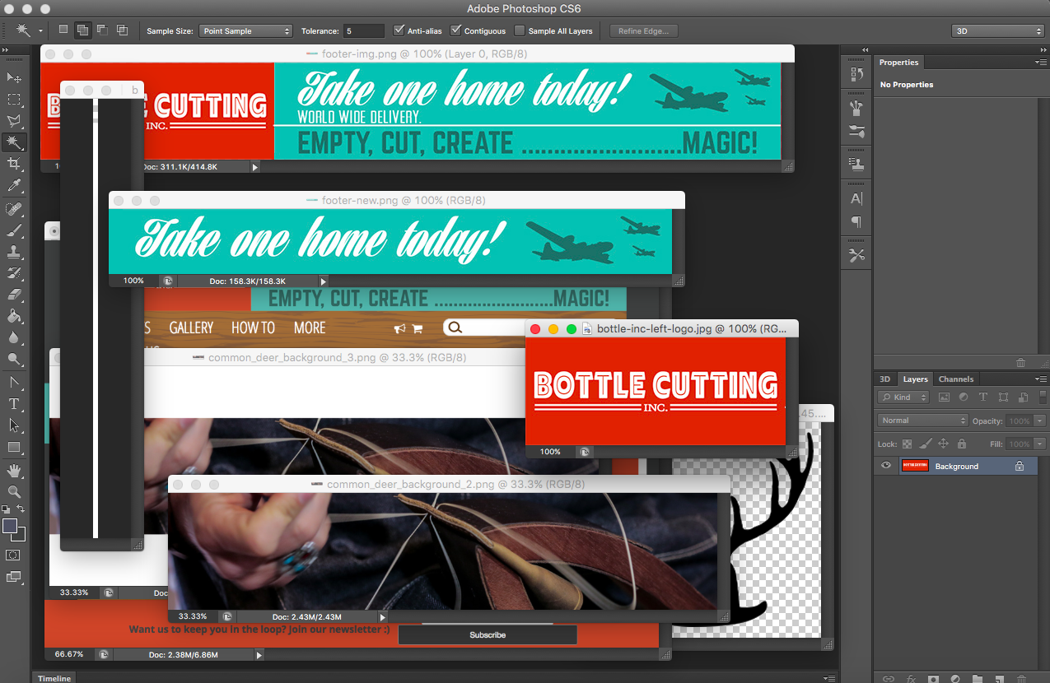
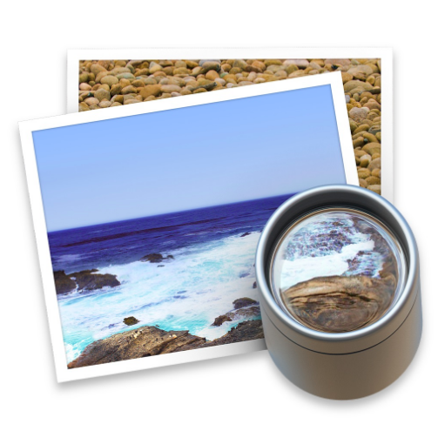
Some Helpful Tools: Image Editor
91766F

Slide 46
Finding your images
Logos
Background Imagery
Brand signature artwork
Iconography

Slide 47
Finding your images

Slide 48
Finding your images

Slide 49
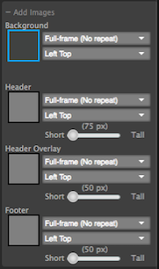
Tips for adding Images
Background – Header - Header Overlay – Footer
Considerations:
Size
Position
Tiling
Using Transparency

Slide 50
Tips for adding images

Slide 51
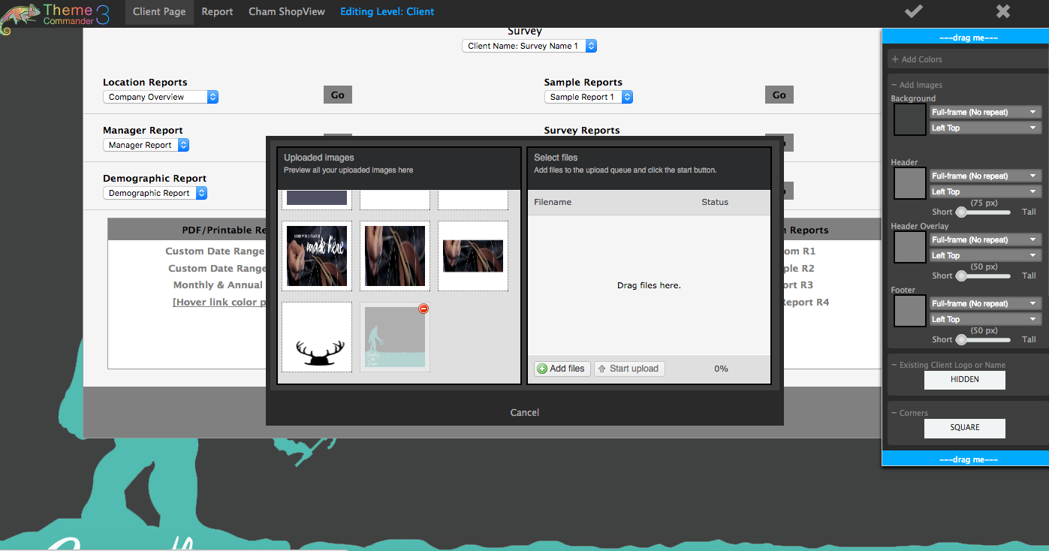
Tips for adding Images

Slide 52
Tips for adding Images

Slide 53
Tips for adding Images

Slide 54
Tips for adding Images

Slide 55
Tips for adding Images

Slide 56
Tips for adding images

Slide 57
Tips for adding images

Slide 58
Making Final Adjustments
Can I easily read everything
Do all the graphics look right
(no odd tiling, images too small/big)
Do all the colors work together
(nothing clashes/too flashy)
Double check all previews
(Client Side/Reports/Chameleon Shop Views)
Does everything ‘Look Right’

Slide 59
Making Final Adjustments
Should I show or hide the logo/client name
Does the Logo appear in an image elsewhere?
Does the Logo look out of place?
Does the Logo obscure or cover something up that it shouldn’t?
Rounded or Square Corners
What does their website use for tables/frames?
Do I want a sharper or softer look?
What ‘looks right’?

