Slide 1
SEO & User Tracking
Tony Breen (Tmark)
tmark@surfmerchants.com

Slide 2
What is SEO?
Search Engine Optimization (SEO): is the process of optimizing your website for a search engine such as Google Yahoo or Bing.
With SEO you can:
Obtain more targeted traffic to your website
Increase website conversions
Lower your marketing budget in the long term.

Slide 3
How Does It Work?

Slide 4
Create A Keyword List
Create a list of keywords related to your goal.
Make sure the keywords bring in a noticeable amount of traffic.
Remember High Search = High Competition

Slide 6
Creating The Content
Focus on quality above all else.
Make it informative
Make it engaging
Include several CTA’s

Slide 7
Optimize Your Content
Include it in the search engine listing title and description.
Make sure to use your keyword in article subheadings.
Try to use the keyword several times within the article as well.
Don’t use your keyword too many times!

Slide 8
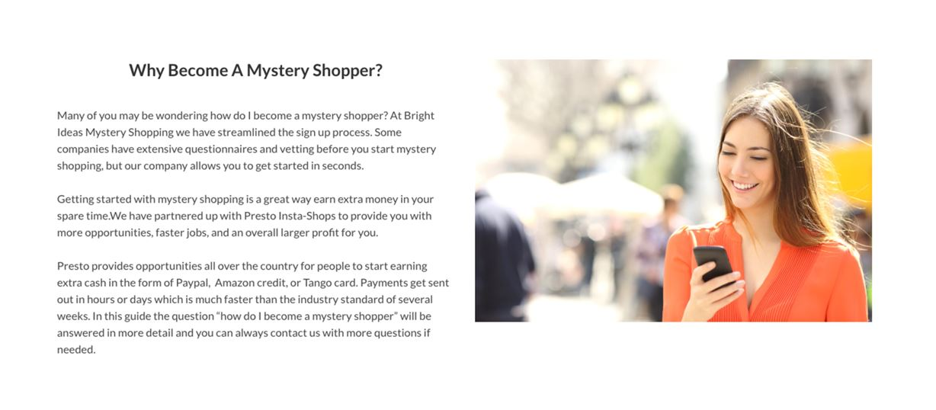
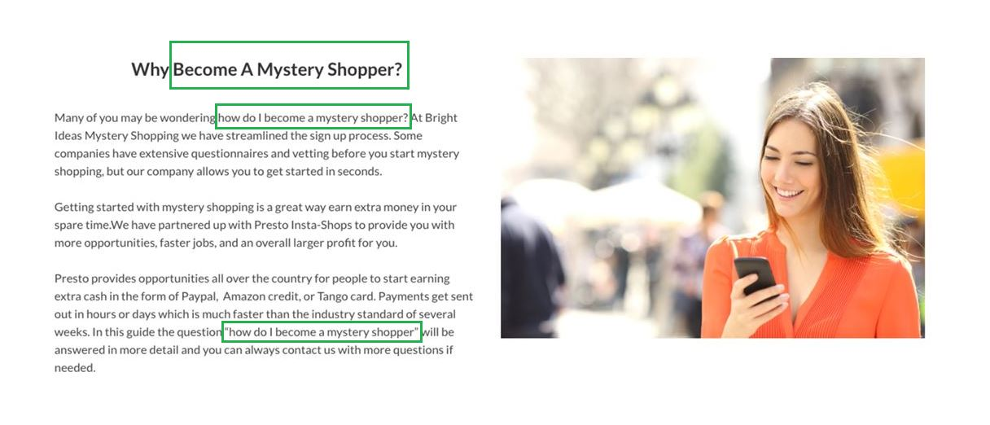

Slide 9
Content Promotion
The most important part of SEO is promotion
Promotion creates links or vouchers back to your content
Not all vouchers are created equal
Can be outside of the mystery shopping industry depending on the topic of your content.

Slide 10
How do you tell if it's working?

Slide 11
Google Search Console & Google Analytics
You can view which sites are linking back from to yours
View which sites are generating the most traffic
You gain value every step of the way

Slide 12
How Do You Know Your Landing Page Works?

Slide 13
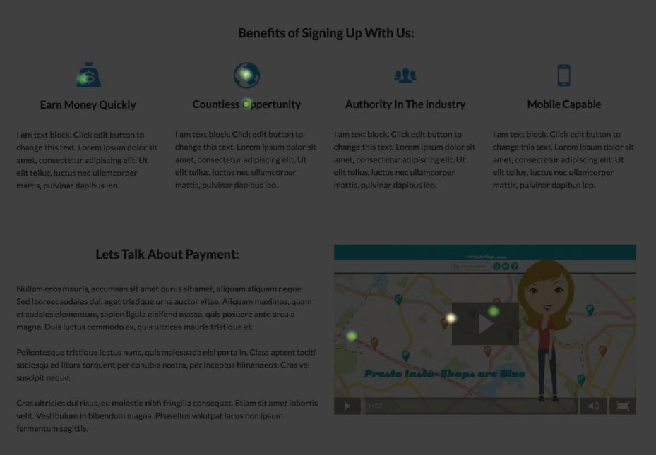
Crazyegg
Find out:
Which sections interest your audience
If they are engaging with your media
Where the common drop-off points are.

Slide 14
Using These Tools To Increase Ad Performance

Slide 15
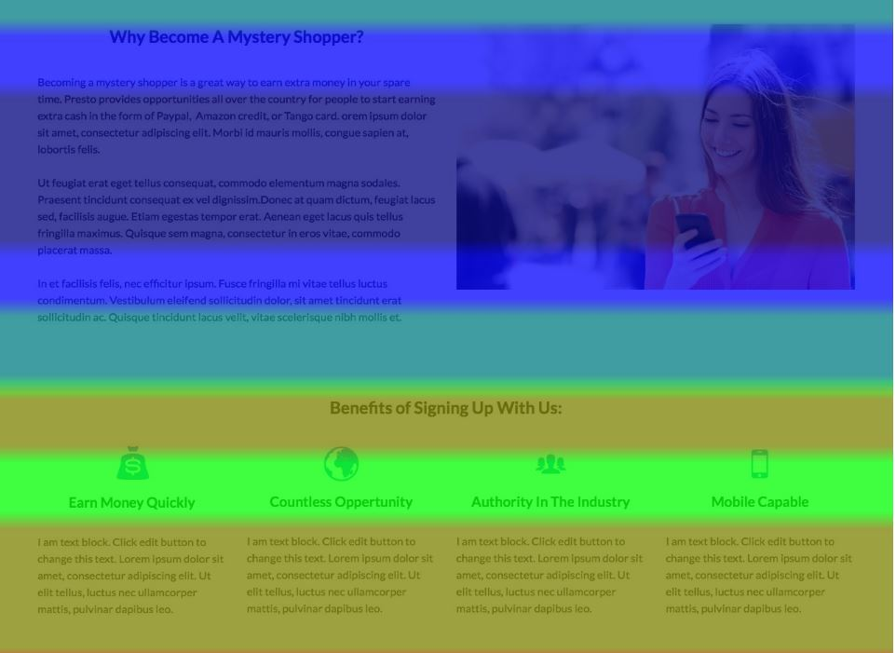
Crazyegg: Heatmaps, Scrollmaps, Overlays
Optimize each page to push people down the funnel
Find out what your viewers are clicking on
Find out where people lose interest on your page
Learn if there is a better place to put a CTA.

Slide 16
Google Analytics
Track users flow down your funnel by campaign, adgroup, ad, or search term
Using funnel visualization, behavior flow, or content drilldown reports
Trigger events when certain elements such as a submit button or video are clicked.

Slide 17
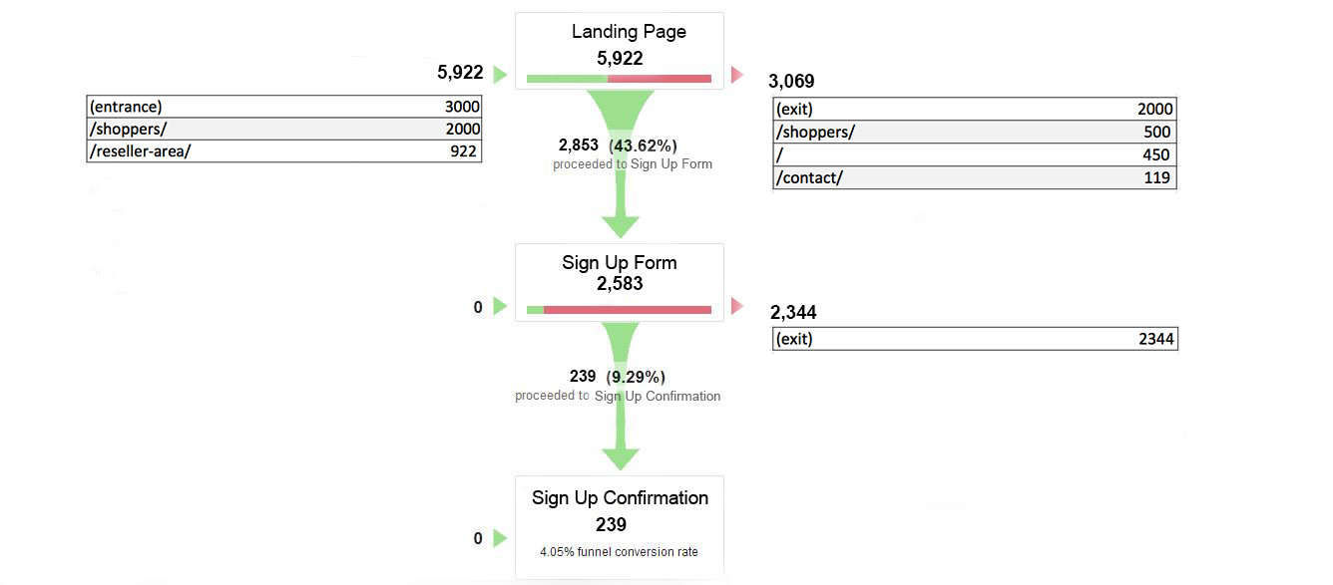

Slide 18
Want To Learn More About The Competition?

Slide 19
Spyfu & Ahref
You can learn:
What keywords other companies have advertised for
What their ads looked like
If they stopped advertising for certain keywords
An estimate of what they were paying
What their landing pages looked like
Find out:
What keywords the competition is ranking for
Where their links are coming from
What content is trending on your topic

Slide 20
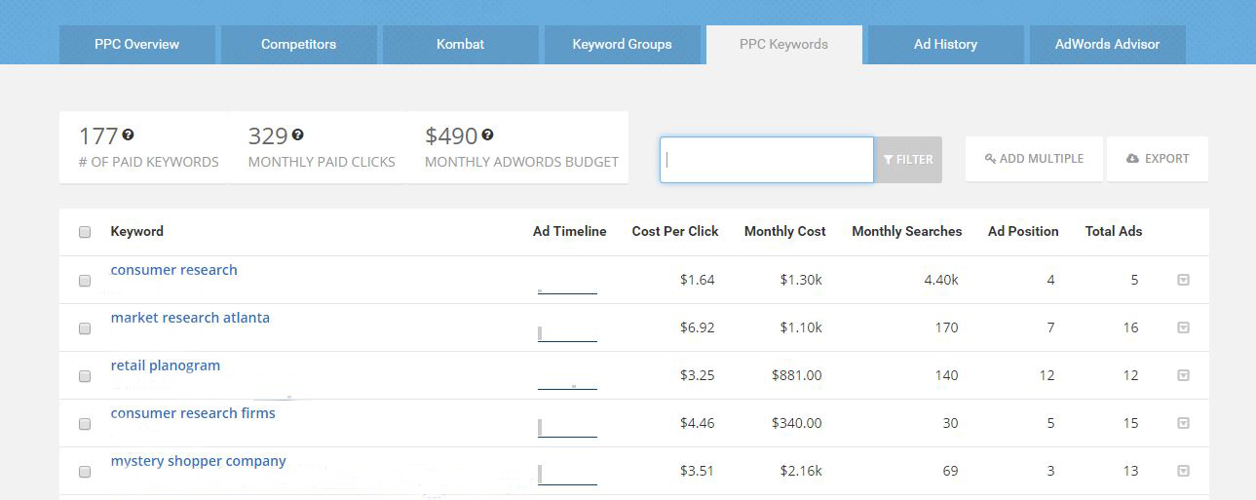

Slide 21
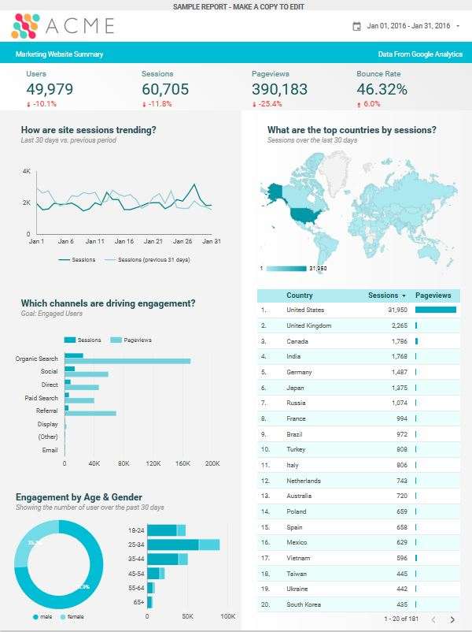
Bonus: Google Data Studio Beta
Create styled reports by importing Analytics, Adwords, or Spreadsheet data
Style pages, reports, or specific graphs
Easy filter and interactive options
https://datastudio.google.com/?hl=en#/org//reporting/0B_U5RNpwhcE6SF85TENURnc4UjA/page/1M

