Slide 2
Stuff RuleZ Can Do!
Check if the store is open or closed
Make sure the shopper is doing the shop on the right day/time
Appear and Disappear relevant questions based on responses
Set answers based on questions/waves/locations/levels/etc

Slide 3
Quick Tips and Tricks
Build from the result you want
Bottom up, not top down
RuleZ Map is your best friend
If you see yellow, you may have an overlap
Question settings must match
Set up conditional requirements on the survey beforehand

Slide 4
Open/Close Check
Q11 is a question with 3 responses about the giftshop
1 is open, 2 is closed, 3 is N/A (if the giftshop isn’t part of the survey)
We want to hide 3 sections (1, 2, 3) when the giftshop is closed or n/a

Slide 5
Quick Tips and Tricks (cont.)
Keep a local copy in a .txt file
Save a new copy each time you update
Test on UAT/STAGE then move to PROD
Keeps your live data safe
For trackers, give support client and survey ID
Also a copy of what you changed/are trying to change

Slide 6
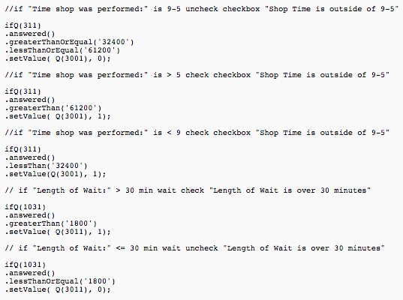
Time Checks
Q311 is a time question, which are defined in seconds
The shop needs to be done between 9 and 5
So we implement a check to confirm the shop is in this timeline

Slide 7
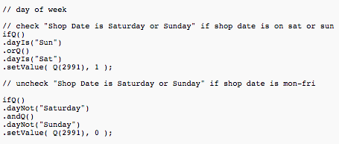
Day Check
.dayIs allows us to check the day of the week (based on Job Date)
This allows us to check if the shop was done on the week or the weekend and fill out a checkbox stating so

Slide 8
Quick Tips and Tricks (end)
.appear/.disappear a question all at once
Build one big rule out of the smaller ones
Use .andifQ or .orifQ to link them
Avoids conflicts and errors
Read the documentation
https://sassierulez.wordpress.com/
It’s the reference I use and evangelize

Slide 9
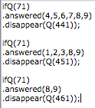
.disappear stacking

Slide 10
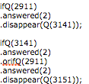
Rule stacking with .orifQ
The top RuleSet is in conflict and we want to fix it
We will build from the target question (Q3151) both instances where it will disappear
This requires rewriting the RuleSet into two different RuleZ, one of which uses .orifQ to link two checks, as seen the in bottom set

Slide 11
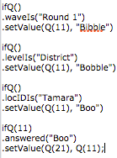
.setValue
A great way to automate forms
Will answer questions based on a trigger
Examples include waves, previous questions, locations, or any other check you can make with RuleZ
You can also set the value to the answer of another question

Slide 12
Questions?

