Slide 2
New Admin Page
Or, How I Learned to Stop Clicking and Love the Quick Jump

Slide 3
Why the changes?
Ease of use
Benefits for new users
Modernize look and feel
TC3 integration
Productivity
Personalized Sassie
Micro Reports

Slide 4
Search Bars
Select client/survey

Slide 5
Search Bars
Quick Jump
Before/after: Setting client theme

Slide 6
BEFORE

Slide 7
AFTER

Slide 8
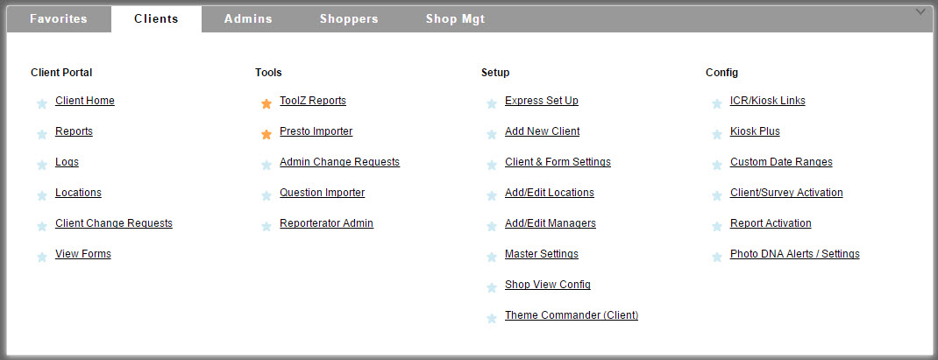
Pick up the tab
Death to dropdowns!

Slide 9
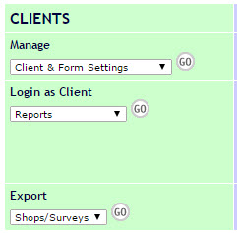
Pick up the tab
Death to dropdowns!

Slide 10
Favorites/Recent

Slide 11
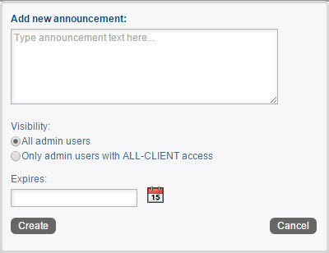
Announcements
Urgent Sassie Announcements
Create your own!

Slide 12
Micro Reports
What?
Why?
Productivity Tool
What do I need to focus on today?

Slide 13
Example 1: Scheduler
What shops are close to overdue?
Red line shows due date
Click through to Urgent Log
Shoppers on a Map

Slide 14
Example 1: Scheduler

Slide 15
Example 2: Reviewer
What shops need to be reviewed today?
Reviewer report
Click through to Admin Shop Log
Pre-filtered to shops that are ready for review

Slide 16
Example 2: Reviewer

Slide 17
Takeaways
Change is good!
Teach Sassie how you work
Reach your employees
Maximize productivity

