Slide 2
Getting Better Results on Custom Projects
Custom Projects are where the toughest clients are won ... and sometimes where time and money go down in horrible defeat. Director of Operations, Robert Swalley draws on decades of experience in how to manage your projects for maximum results and minimal heartache.

Slide 3
Sell What You Have
Dragon Dashboards
Dragon Shop Views
Theme Commander 3
ToolZ Reports and Widgets

Slide 4
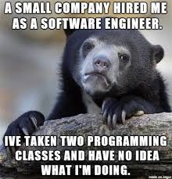
Sell What You Have
No Programming Degree necessary!
No mad Photoshop chops required!

Slide 5
Sell What You Have
Activate only the reports that make sense for this client
It’s not about having the most reports but rather the RIGHT reports
Sell your expertise

Slide 6
So Your Client Is Asking You To Customize The System So You Come To Us For Help
Determine the business need and let us propose the solution

Slide 7
So Your Client Is Asking You To Customize The System So You Come To Us For Help
New to SASSIE?

Slide 8
Concierge

Slide 9
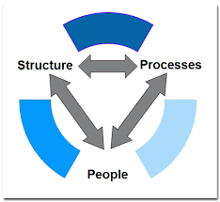
Ok So You’ve Determined You Have To Customize, Now What?
Understand Our Process And Structure

Slide 10
Support Structure
Tier One Support
SPS – Support Project Services
Project Teams

Slide 11
Support Structure
Tier One Support
Tracker
Live Chat

Slide 12
Support Structure
SPS – Support Project Services
Small quick mini “projects”
Database manipulations
One time queries
One-off exports
Custom Templates
ToolZ reports and Widgets

Slide 13
Support Structure
Project Teams
Project Manager
Developer
QA Engineer
Big Projects
Custom Reports
Action Plans
SSO’s

Slide 14
Project Process
http://go.sassiex.com/ProjectProcess
1. Tracker Request comes in
2. Ballpark estimate obtained during PM Huddle
3. Estimate accepted
4. Basic requirements are confirmed
5. Project gets scheduled with due dates
6. Detailed requirements are gathered
7. Spec written
8. Spec approved
9. Development / QA cycle

Slide 15
Project Process
http://go.sassiex.com/ProjectProcess
10. Deliver to UAT for client approval. Invoice client.
a. UAT is often called “the place code goes to die”. If you never approve your customization to go live, you will be billed for it but it will never go live. This is an extremely important step.
b. This is where you can identify any missed spec items or things that are not functioning properly. This is NOT a place to “Trial and Error code”. If you want additional functionality that wasn’t previously requested you can ask to get an estimate on a Phase 2.

Slide 16
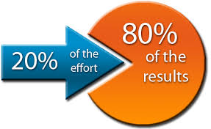
Do Only What Is Necessary
80/20 rule – 20% of the effort gets 80% of the solution
To get the remaining 20% of the solution takes 80% of the effort
Effort = Time and money
The 80% option is often good enough

Slide 17
Do Only What Is Necessary
Three Estimates:
1. FREE or DIY
2. 80% Solution
3. The Whole Enchilada

Slide 18
So Now You’ve Gotten Your Estimates And Are Thinking:
Wow, I really don’t want to do the $10k option, how do I get them to do the $2k option?

Slide 19
How do I get them to do the 80% option?
MVP
Phase 2

Slide 20
The Client Has Accepted The Estimate, Now What?
Follow the Project Process
Obtain the FULL requirements up front
Understand the requirements
Actively participate

Slide 21
The Client Has Accepted The Estimate, Now What?
Review the Spec and sign off on it
Review the finished solution when presented on UAT.

Slide 22
Conclusion
The big take-aways are as follows:
Help us help you
bring the business need, not the solution
Sell what we have first
Do only what is necessary
Obtain ALL of the requirements up front
Actively participate

Slide 23
Getting Better Results on Custom Projects
Custom Projects are where the toughest clients are won ... and sometimes where time and money go down in horrible defeat. Director of Operations, Robert Swalley draws on decades of experience in how to manage your projects for maximum results and minimal heartache.

